Slide 1
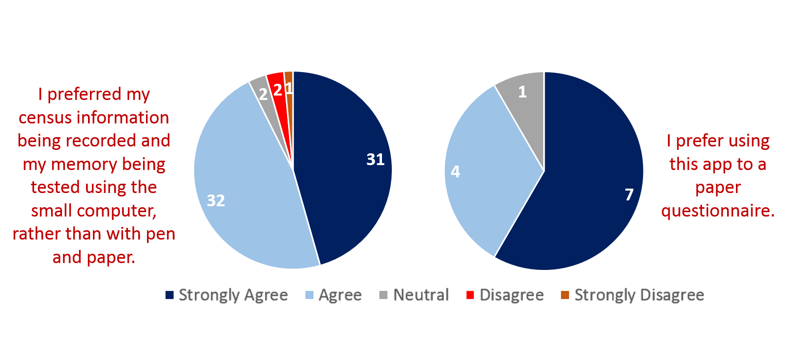
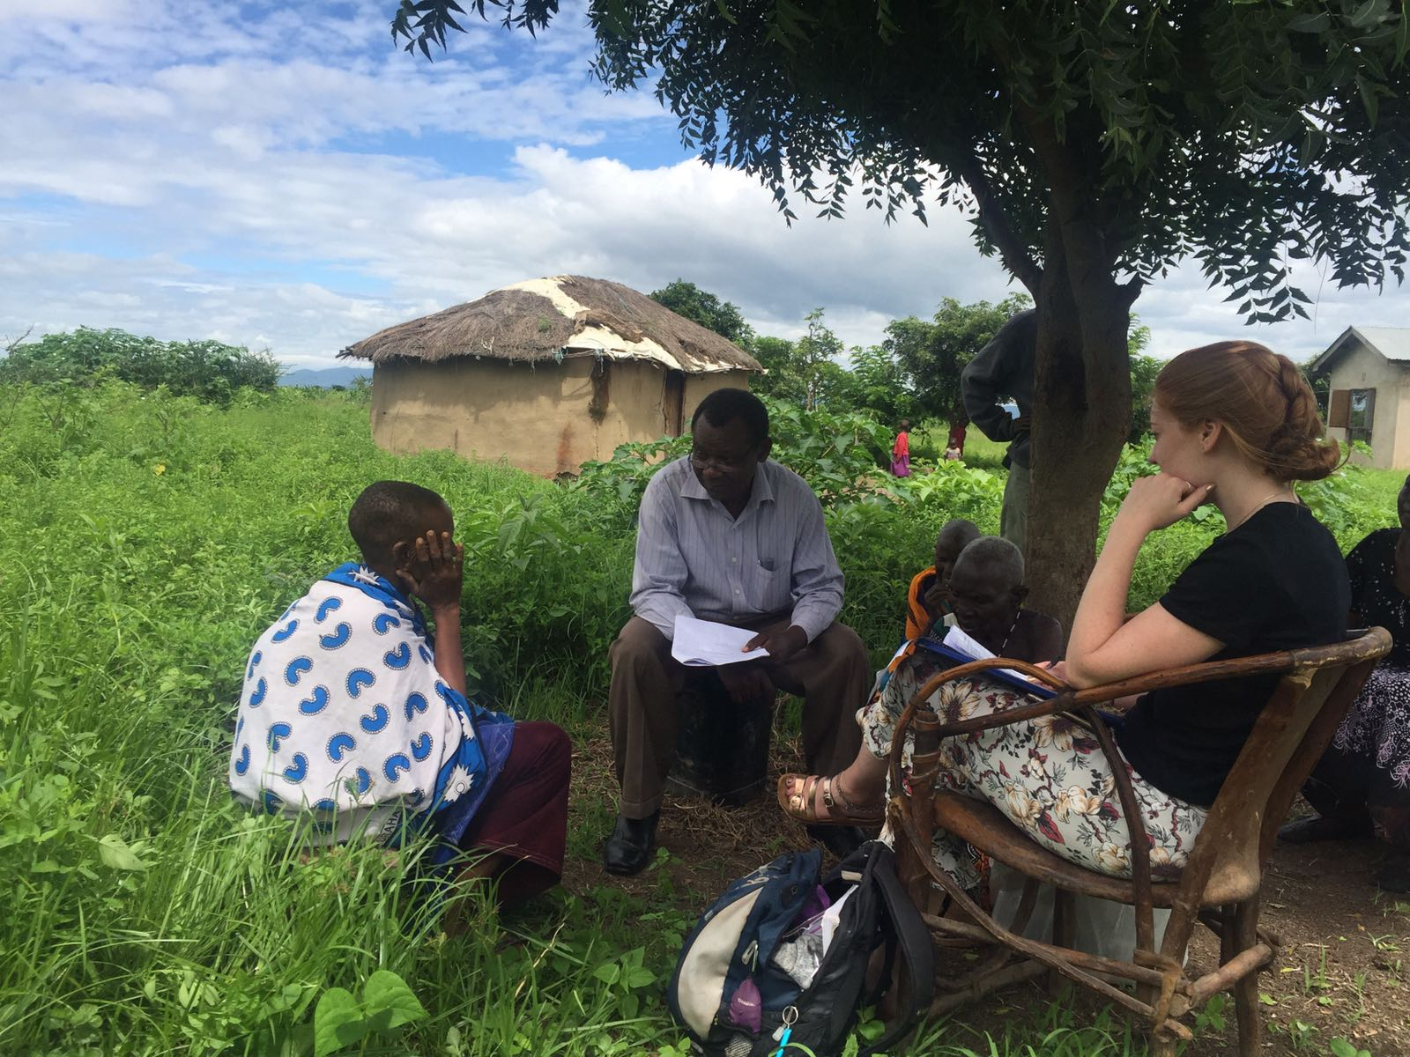
Feasibility of a Dementia Screening App In Tanzania
R Barber1, A Colgan1, S-M Paddick2,3, A Damas4, S Safic5, D Mushi6, J Kisima7, I Haule7, W K Gray8, C Dotchin8,9, L Robinson9, R Walker8,9
1. Faculty of Medical Sciences, Newcastle University, UK, 2. Institute of Neuroscience, Newcastle University, Uk, 3. Northumberland Tyne and Wear NHS Foundation Trust, UK, 4. National Psychiatric Hospital Dodoma Tanzania, 5. Arusha Mental Health Trust, Tanzania, 6. Kilimanjaro Christian Medical University College (KCMCo) Tanzania, 7. Hai District Medical Office, Tanzania, 8 Northumbria Healthcare NHS Foundation Trust 9. Institute of Health and Society, Newcastle University, UK
Dementia is a syndrome of chronic neurodegeneration, characterised by progressive memory loss and cognitive decline¹. It is characteristically a condition of older people, although it is not a normal part of ageing¹. There is no cure for dementia, however early detection can lead to intervention and slower progression of symptoms².
The elderly population in Sub-Saharan Africa (SSA) is increasing more rapidly than anywhere else worldwide, and reflecting this is a rapid increase in dementia prevalence³. However, in such resource-poor areas, psychiatric specialists are few, and unable to deal with the rising burden of dementia³. Screening tools which are appropriate for use in low education settings and can be administered by non-specialists are therefore needed³.
Utilising an app for screening would allow regular best practice updates and decision making support to be delivered remotely, therefore aiding patient care. Never before has a study investigated the feasibility of using an app to allow rural villagers without mental health training to screen for dementia in SSA.
An App was created, containing a census proforma and a digital format of the ‘Six Item Dementia Screening for Africa’ (SIDSA), a tool which has previously been validated as a pen and paper screening test in Tanzania⁴.
Phase 1:
Enumerators (local villagers, regularly employed to assist with research) for 12 villages in the Hai district of Tanzania were given standardised training for the new device.
Each enumerator then used the app to carry out a census of their village.
Those identified as ≥60 years in the census who consented were screened.
Phase 2:
In two focus villages, those screened were stratified based upon their cognitive score, then randomly selected for phase 2. All of those scoring poorly were selected, 50% scoring moderately and 10% of those who scored well.
Selected participants were assessed in greater detail by research students - blinded to screening scores - and a provisional judgment of cognitive functioning was given.
Figure 1 – Study Procedure
Feedback
Enumerators and those participants seen in phase 2 were given Likert-style questionnaires to explore their experiences of using the app.
1. INTRODUCTION
3. METHODS
To screen all adults aged over 60 throughout twelve villages in rural Tanzania, using an app-based dementia screening tool.
To establish the feasibility of the app by evaluating its construct validity and gaining feedback from those delivering and receiving the screening.
2. AIMS
Construct Validity
Screening scores were compared with factors known to be associated with dementia
Table 1 – Correlation between SIDSA score and dementia-predictive variables.
Feasibility
Practicality - 98.5% of participants asked were impartial or happy for the electronic device to be used to guide their screening
4. RESULTS
Time Taken – 77.9% of participants felt that the time taken (mean = 21.98 minutes) was acceptable, however 11/12 enumerators reported that the screen was too time consuming.
Future Use – The majority of participants and enumerators preferred the app to pen and paper tests. All enumerators stated that the app would be useful for their future work and that it would make them more likely to evaluate memory.
Figure 2 – Participant (left) and enumerator (right) preferences on screening methods
 | N = | Correlation Coefficient | P Value
Age | 407 | -0.479 | <0.001
Educational level | 407 | 0.394 | <0.001
Informant reported functioning | 159 | 0.609 | <0.001
Reciprocal coordination test (sequencing) | 84 | 0.543 | <0.001
Number of days of the week named backwards (attention) | 77 | 0.634 | <0.001
Provisional cognitive impairment diagnosis | 84 | -0.348 | 0.01
Feasibility
Practicality – Enumerators reported that the app and computer-tablet were both simple to use. However 25% reported difficulties with keeping the tablet charged.
Using an app to screen for dementia in a rural Tanzanian population was acceptable and preferred to the equivalent pen and paper test.
Poor screening scores from the app correlated with factors known to be associated with dementia
A potential barrier to large-scale use of the app in this setting is the unreliable electricity supply, which may prevent regular charging of smart-device batteries.
5. CONCLUSIONS
Building upon this work, future studies should be done to:
Confirm the validity of the app in this rural village setting. This would require a psychiatrist’s formal diagnoses to be given to those seen in phase 2.
Investigate the validity and feasibility of the app in a healthcare setting.
Investigate the validity and feasibility of the app in other low income, low literacy settings.
6. FUTURE WORK
Figure 3 – Administering the feedback questionnaire
I would like to give my sincerest thanks to the 12 enumerators, fellow research student and local doctors with whom I worked in Tanzania. My gratitude also to Professor Richard Walker, Keith Gray, Dr Stella Paddick and Dr Catherine Dotchin for their support.
World Health Organisation. Dementia Fact Sheets 2017 12/12/2017 [cited 2018 24/06/2018]; Available from: http://www.who.int/news-room/fact-sheets/detail/dementia
Robinson L, Tang E, Taylor J-P. Dementia: timely diagnosis and early intervention. The BMJ. 2015 06/16;350:h3029
Guerchet MM, Mayston R, Lloyd-Sherlock P, Prince MJ, Aboderin I, Akinyemi R, et al. Dementia in sub-Saharan Africa: challenges and opportunities. London: Alzheimer's Disease International. 2017.
Gray WK, Paddick S-M, Kisoli A, Dotchin CL, Longdon AR, Chaote P, et al. Development and Validation of the Identification and Intervention for Dementia in Elderly Africans (IDEA) Study Dementia Screening Instrument. Journal of Geriatric Psychiatry and Neurology. 2014.
7.ACKNOWLEDGEMENTS
8. REFERENCES

